Slide 1
Secure data hiding in images using steganography
CAPSTONE PROJECT
Presented By: Dinesh Malem
Student Name : Dinesh Malem
College Name & Department : Sree Vidyanikethan Engineering College & Information Technology

Slide 2
OUTLINE
Problem Statement
Technology used
Wow factor
End users
Result
Conclusion
Git-hub Link
Future scope

Slide 3
Problem Statement
This project focuses on secure data hiding using steganography to enhance digital communication security. Existing methods face challenges like low embedding capacity, image distortion, and vulnerability to detection. The goal is to develop a robust technique that ensures high imperceptibility and maintains image quality.

Slide 4
Technology used
Libraries Used : cv2, os, String
Platform Used : IDLE (Python 3.11 64 – bit)

Slide 5
Wow factors
This project stands out by integrating advanced cryptographic techniques for enhanced security while optimizing both data capacity and image quality. It resists steganalysis, making hidden data harder to detect, and supports multiple image formats. Additionally, its scalability allows applications in secure communication, watermarking, and digital forensics.
Unique Features:
Improved Security Measures
Enhanced Security
Minimal Image Distortion

Slide 6
End users
Government Agencies & Defence
Cybersecurity Professionals
Corporate Organizations
Forensic Experts & Law Enforcement
Journalists & Whistleblowers

Slide 7
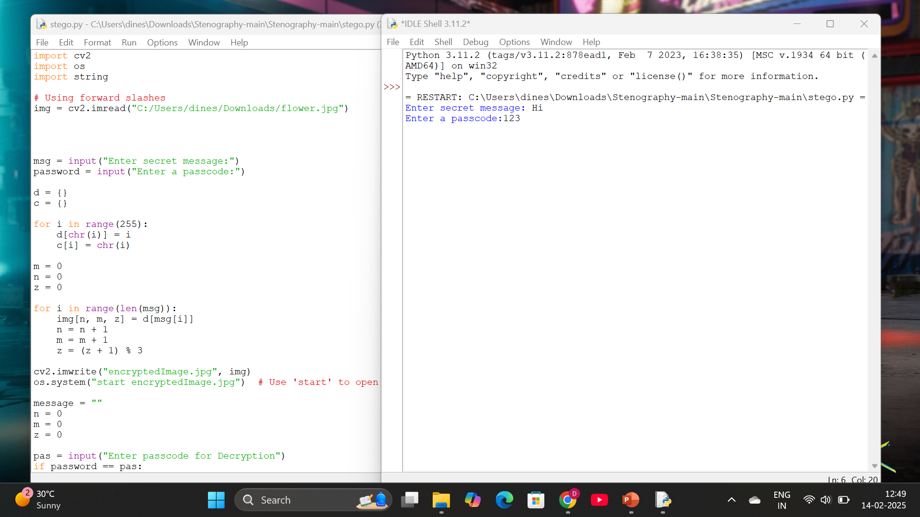
Results

Slide 8
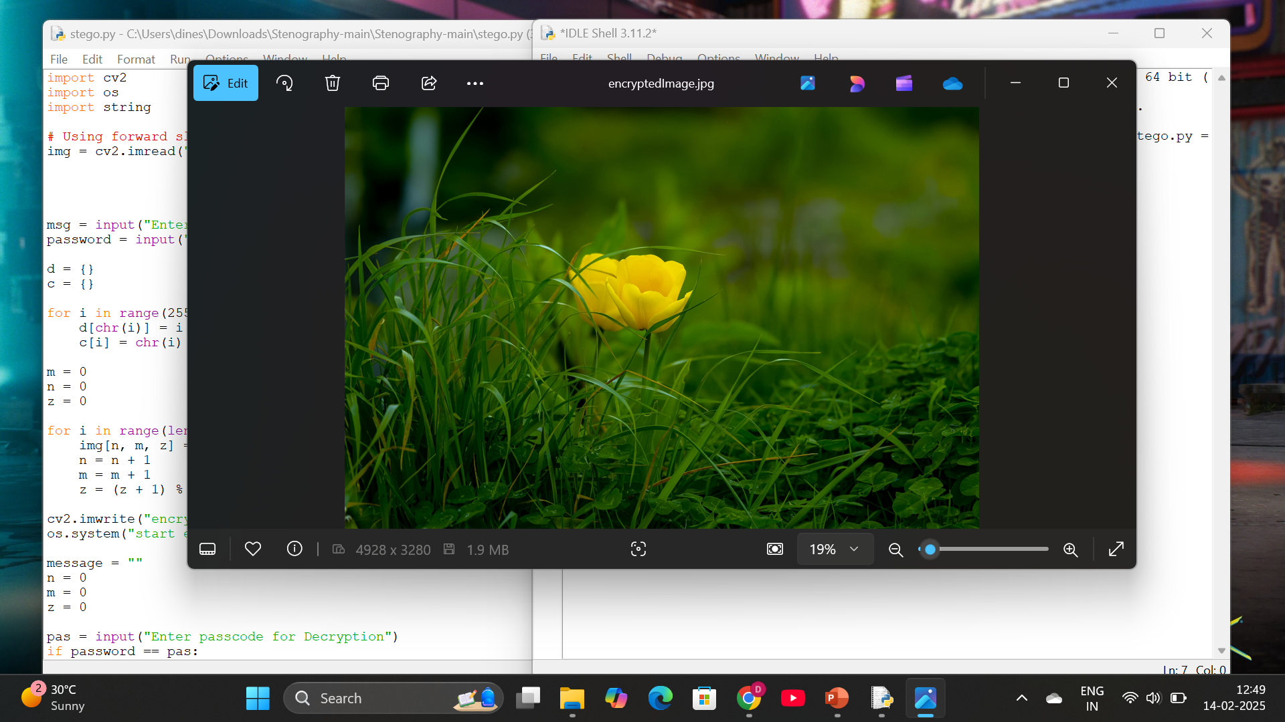
Encrypted Image

Slide 9
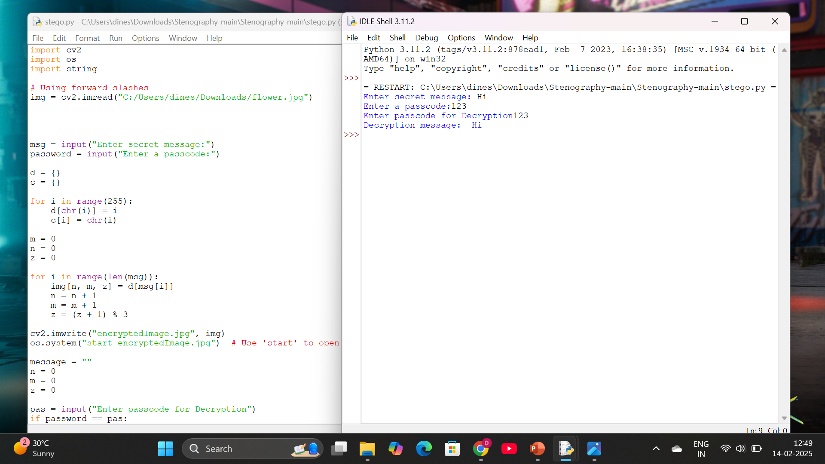
Decrypted message

Slide 10
Conclusion
Steganography provides a powerful and innovative approach to secure data hiding by embedding information within images while ensuring minimal detectability. This project enhances traditional steganographic techniques by improving security, embedding capacity, and resistance to detection methods. With applications in cybersecurity, government, corporate security, and personal privacy, it offers a versatile solution for safeguarding sensitive information. By maintaining image quality and ensuring robust encryption, this project contributes to secure digital communication in an increasingly data-driven world.

Slide 11
GitHub Link
https://github.com/DineshMalem/Secure-Data-Hiding-in-images-using-steganography.git

Slide 12
Future scope(optional)
The future of steganography in secure data hiding is promising, with advancements in AI-powered techniques to optimize embedding and enhance security. Quantum steganography could revolutionize encryption, making data transmission nearly unbreakable. Adaptive steganography will allow dynamic embedding based on image properties, improving imperceptibility. Real-time steganography can enable secure live communication, while cloud-based storage integration will enhance encrypted data sharing. Blockchain technology could authenticate hidden data, ensuring security in digital transactions.

Slide 13
THANK YOU

